Slide 1
D-Labeled
Reagents
www.clearsynth.com
"The 'Catalyst' in making your research work"

Slide 2
D-Labeled Reagents
Clearsynth is a technology based, research driven enterprise and leading service provider in the pharmaceutical industry committed to turning your ideas into success. Our goal is to offer you the best individually tailored solution for your project and needs and we are pleased to offer more new potential D-labeled reagents which will help in your research.

Slide 3
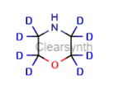
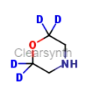
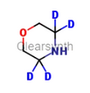
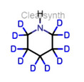
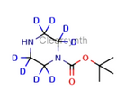
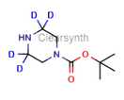
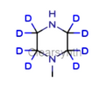
Amines
Morpholine - D8
CAT No.: CS-T-58971
2,2,6,6-Morpholine-D4
CAT No.: CS-O-36694
3,3,5,5-Morpholine-D4
CAT No.: CS-O-36696
Piperidine-D10
CAT No.: CS-T-60606
Amines
N-Boc-piperazine D8
CAT No.: CS-T-49548
Piperazine-3,3,5,5-D4-N-t-BOC
CAT No.: CS-C-00441
N-Boc-piperazine-2,2,6,6-D4
CAT No.: CS-TA-63117
N-methylpiperazine D8
CAT No.: CS-O-16257

Slide 4
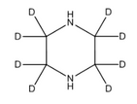
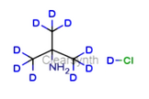
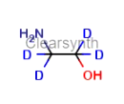
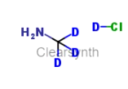
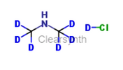
Amines
Piperazine D8
CAT No.: CS-O-30499
Diethanol Amine D8
CAT No.: CS-O-10423
tert - Butyl D9-amine DCl
CAT No.: CS-O-16360
Ethanol Amine D4
CAT No.: CS-O-20024
Methylamine D3 DCl
CAT No.: CS-O-36693
Diethylamine-D4 DCl
CAT No.: CS-O-36692
Diethylamine-D10
CAT No.: CS-O-03342
Dimethylamine-d6 DCl
CAT No.: CS-O-36691

Slide 5
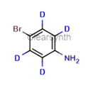
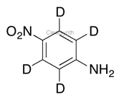
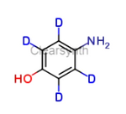
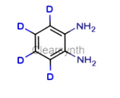
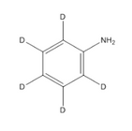
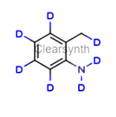
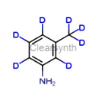
Anilines
4-Bromoaniline D4
CAT No.: CS-C-00175
4-Nitroaniline D4
CAT No.: CS-T-59322
4-Hydroxyaniline D4
CAT No.: CS-O-33121
o-phenylenediamine D4
CAT No.: CS-O-16229
Aniline D5
CAT No.: CS-T-48261
o-Toludine-D7
CAT No.: CS-T-62124
m-Toludine-D7
CAT No.: CS-T-93800

Slide 6
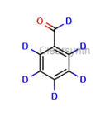
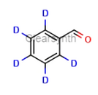
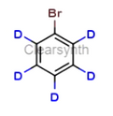
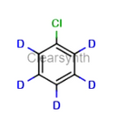
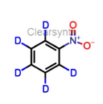
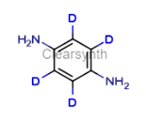
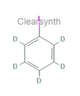
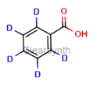
Benzene
Benzene
Benzaldehyde D6
CAT No.: CS-O-14865
Benzaldehyde D5
CAT No.: CS-T-48561
Bromobenzene- D5
CAT No.: CS-O-10893
Chlorobenzene- D5
CAT No.: CS-T-50563
Nitrobenzene D5
CAT No.: CS-T-59336
1.4-Diaminobenzene-D4
CAT No.: CS-T-60413
Iodobenzene-D5
CAT No.: CS-ZG-22484
Benzoic Acid- D5
CAT No.: CS-T-48678

Slide 7
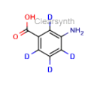
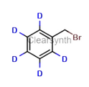
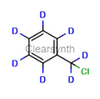
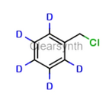
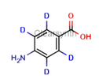
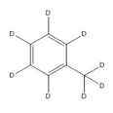
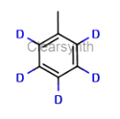
Benzene
3-Aminobenzonic acid -D4
CAT No.: CS-CX-00353
Benzyl bromide D7
CAT No.: CS-O-10415
Benzylbromide D5
CAT No.: CS-T-48831
Benzyl Chloride D7
CAT No.: CS-C-00300
Benzyl Chloride D5
CAT No.: CS-T-48832
4-Aminobenzoic acid D4
CAT No.: CS-T-47620
Toluene D8
CAT No.: CS-T-62117
Toluene-D5
CAT No.: CS-O-11244

Slide 8
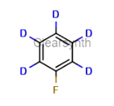
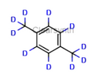
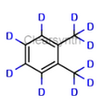
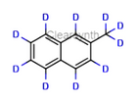
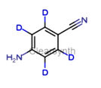
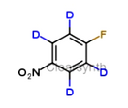
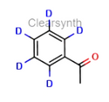
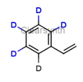
Benzene
Benzene
Fluorobenzene-D5
CAT No.: CS-CE-00852
p- Xylene D10
CAT No.: CS-CE-00809
o-Xylene D10
CAT No.: CS-O-14867
2-Methylnaphthalene-d10
CAT No.: CS-O-11246
4-Aminobenzonitrile-2,3,5,6-d4
CAT No.: CS-O-36870
4-fluoronitrobenzene-D4
CAT No.: CS-O-36871
Acetophenone D5
CAT No.: CS-O-02954
Styrene D5
CAT No.: CS-T-61434

Slide 9
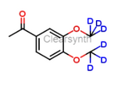
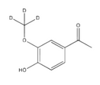
Benzene
Benzene
Acetoveratrone-d6
CAT No.: CS-O-36875
Acetovanillone D3
CAT No.: CS-T-47001
4-Hydroxy-3-methoxybenzaldehyde D3
CAT No.: CS-T-56134

Slide 10
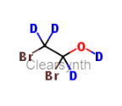
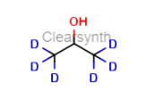
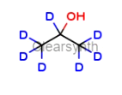
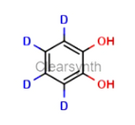
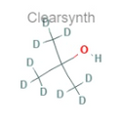
Alcohol
Alcohol
2-Bromoethanol-D4
CAT No.: CS-O-01278
1,2-Dibromoethanol D4
CAT No.: CS-O-36690
2-Chloroethanol D4
CAT No.: CS-T-50655
Isopropanol D6
CAT No.: CS-O-13780
Isopropanol-D7
CAT No.: CS-T-56839
Catechol-D4
CAT No.: CS-T-50405
tert-Butanol-d9
CAT No.: CS-ZG-31193
2 Bromoethanol D4
CAT No.: CS-O-01278

Slide 11
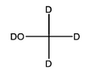
Alcohol
Alcohol
MeOD
CAT No.: CS-T-57790
Phenol D5
CAT No.: CS-T-60354
Bromophenol-D4
CAT No.: CS-C-00234
4-Aminophenol-D4
CAT No.: CS-O-33121
Glycerol D5
CAT No.: CS-T-55391
EtOD
CAT No.: CS-T-54279
CD3OD
CAT No.: CS-T-57790
Cyclohexanol-D11
CAT No.: CS-BX-00303

Slide 12
Alcohol
Alcohol
Cyclopentanol-d9
CAT No.: CS-O-36684
Methyl iodide- D3
CAT No.: CS-O-10421
Cyclopentyl Bromide-D9
CAT No.: CS-C-00153

Slide 13
Ketones
Ketones
Acetone D6
CAT No.: CS-T-46994
Cyclopentanone D8
CAT No.: CS-O-15560
Cyclohexanone D4
CAT No.: CS-BX-00304

Slide 14
Alkanes
Alkanes
Dibromomethane D2
CAT No.: CS-BX-00568
Dichlomethane D2
CAT No.: CS-T-33750
1-Bromo, 2-chloroethane D4
CAT No.: CS-C-00154
1,2-dichloroethane D4
CAT No.: CS-T-52615
Isopropyl bromide D6
CAT No.: CS-T-49864
Isopropyl bromide-D7
CAT No.: CS-T-49863
2-chloroacetic acid D2
CAT No.: CS-O-36683
2 Bromopropane D7
CAT No.: CS-T-49863

Slide 15
Alkanes
Alkanes
CD3I
CAT No.: CS-O-10421
1-Bromo-2-Cholorethane-D4
CAT No.: CS-C-00154
Epichlorohydrin D5
CAT No.: CS-T-54063
CDCl3
CAT No.: CS-T-50737
TMSI D9
CAT No.: CS-O-36688

Slide 16
D-Amino Acids
D- Amino Acids
D-Phenylalanine D5
CAT No.: CS-O-11336
D-(-)-2-Phenylglycine D5
CAT No.: CS-O-16261
D-Alanine-3,3,3 D3
CAT No.: CS-C-00215
D-Alanine D4
CAT No.: CS-O-15399
D-Leucine-5,5,5-d3
CAT No.: CS-O-36876
D-Leucine-D6
CAT No.: CS-O-36877

Slide 17
L-Amino Acids
L- Amino Acids
L-Phenylalanine D5
CAT No.: CS-T-83960
L-(+)-2-Phenylglycine D5
CAT No.: CS-T-84884
L-Alanine D3
CAT No.: CS-C-00225
L-Alanine D4
CAT No.: CS-T-47488
L-Leucine-5,5,5-d3
CAT No.: CS-T-57210
L-Leucine-D6
CAT No.: CS-O-36878

Slide 18
D-Nitroso Compounds
D-Nitoso compounds
N-Nitrosodimethylamine D6
CAT No.: CS-T-59622
N-Nitrosodiethylamine D4
CAT No.: CS-T-59619
N-Nitrosopiperidine D4
CAT No.: CS-T-59647
N-Nitrosomorpholine D4
CAT No.: CS-T-59546
N-Boc-N-Nitrosopiperazine-d4
CAT No.: CS-O-36879
N-Methyl-N’-nitrosopiperazine D4
CAT No.: CS-T-81300
N-Nitrosodibutylamine-d4
CAT No.: CS-O-36880

Slide 19
Others
Others
DMSO D6
CAT No.: CS-T-53699
NaOD (40% in D2O)
CAT No.: CS-O-15142
D2SO4
CAT No.: CS-O-13174
DCl in D2O
CAT No.: CS-T-52330
DBr in D2O
CAT No.: CS-CE-00821

Slide 20
WORLDWIDE HELPLINE NO.: +1-415-685-4395
Email: sales@clearsynth.com | Web: www.clearsynth.com
CANADA (Toronto) : 118 Queen Street,,Unit 202,Brampton, Ontario, 6X 1A4Tel : +1-289-729-0060
USA (New Jersey) : 155 Pierce Street,Unit 7,Somerset, NJ - 08873. Tel : +1 (732) 271-4503, +1 (732) 271-4297
BRAZIL (São Paulo) : Rua Campos Salles 116,Centro, Artur Nogueira - São Paulo,Cep 13.160-118. Tel : +55 19 38276034
FRANCE (Villeurbanne) : 50 Rue Descartes, 69 100 Villeurbanne, France. Tel : +33 (0) 649 98 20 78
CHINA (Shenzhen) : 4A,Building A6, China Merchants GuangMing Park,Fenghuang Street,Shenzhen.Tel : +86-0755-21386149
INDIA (Mumbai) : 17, Lotus Business Park, Andheri West, Mumbai - 400 053. Tel : +91-22-45045900
INDIA (Hyderabad) : Plot No. 177, IDA,Mallapur, Hyderabad - 500076. Tel : +91-40-27155481

